Slide 1
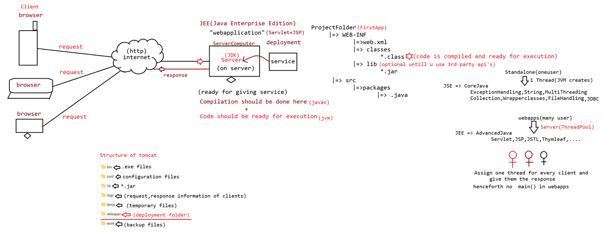
Web Applications (Servlets, JSP,…) are hosted on Servers
(Web application folder on server)
(server)

Slide 2
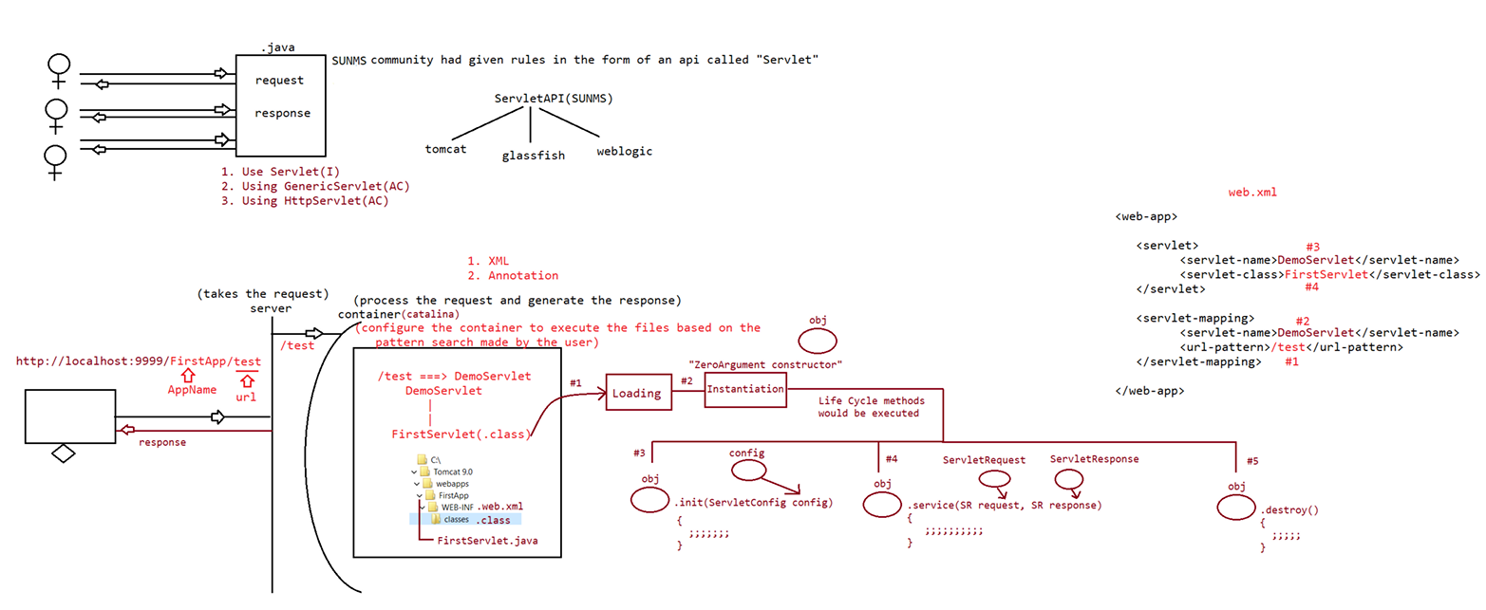
Implementation for this API is given by the vendors who are providing servers to host our web applications such as tomcat, glassfish, weblogic,…
In order to server multiple users at a time
Using these 3 ways we can create Servlets i.e web applications
This can be done in two ways:
Using web.xml file
@webservlet annotation

Slide 3
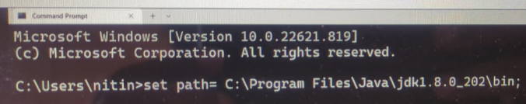
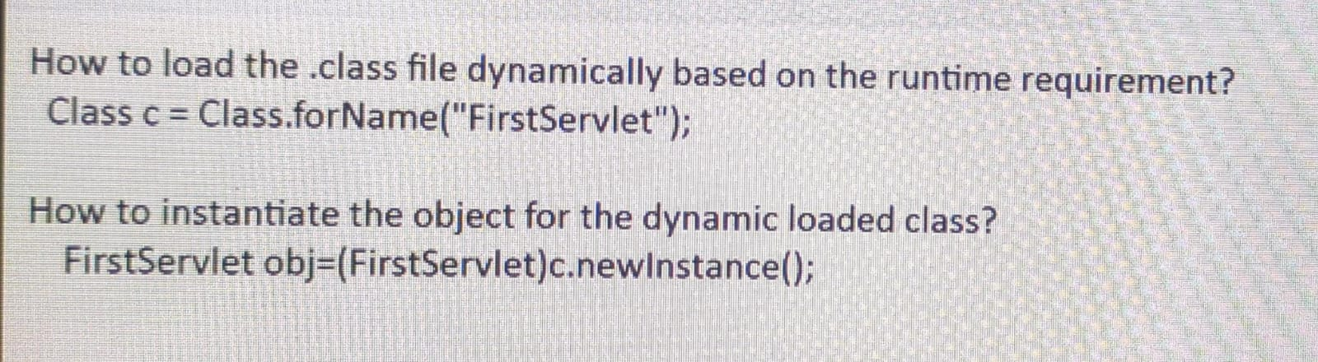
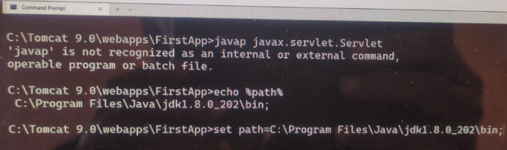

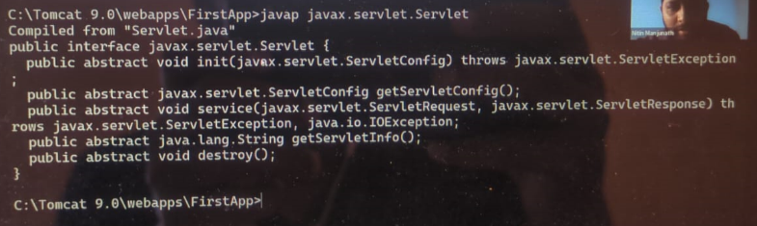
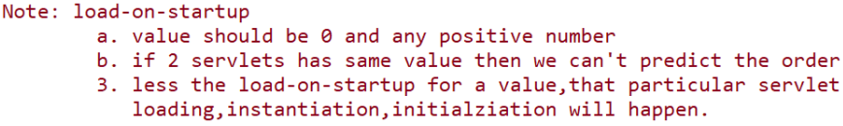
What does ‘cls’ command do in command prompt?

Slide 4
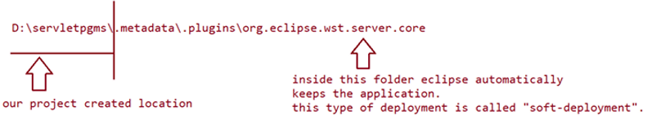
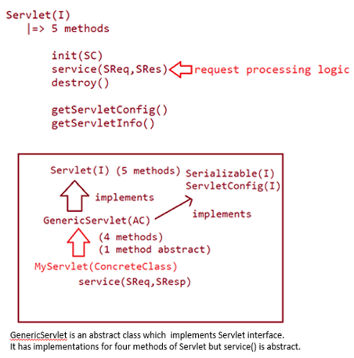
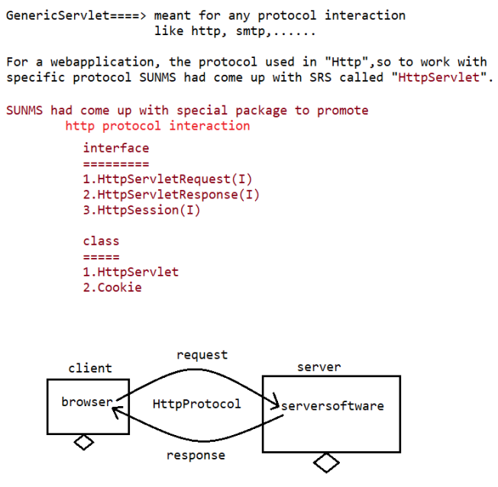

Slide 5
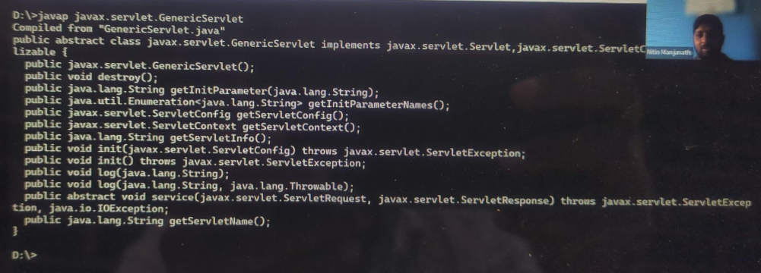
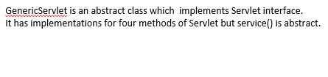
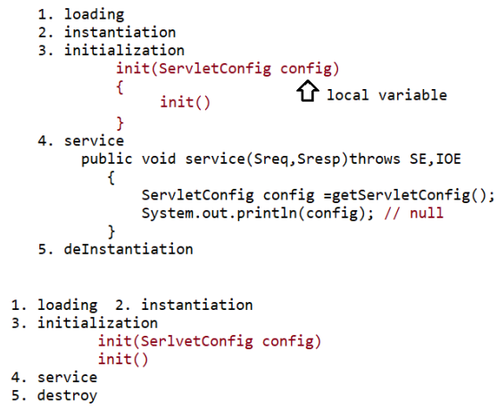
Why two init methods in GenericServlet (AC)?
The one with the parameters is called by Web Container
The Parameterles init() is used by developers.
If you override init(ServeltConfig config) method recklessly you may loose the local config variable. Then, getSerlveltConfig() gives null; which is not all good.
If you need init method, then always override init() method because the init(ServletConfig config) method internally calls init() method

Slide 6
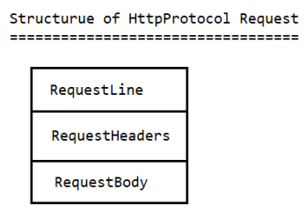
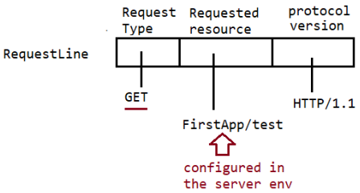
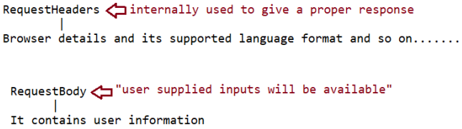
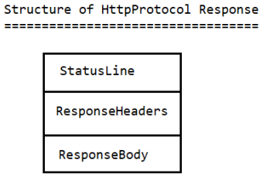
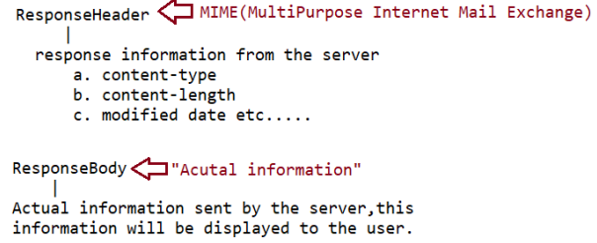
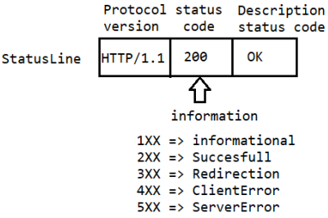
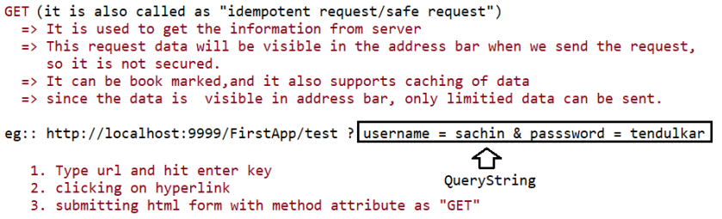
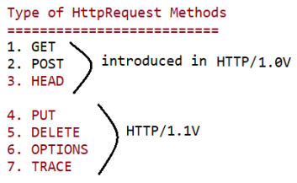
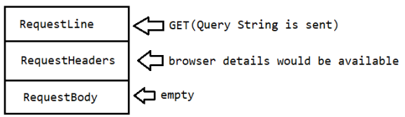
Used in Spring REST API

Slide 7
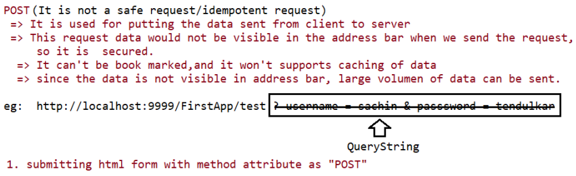
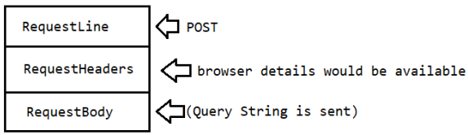
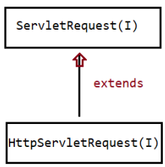
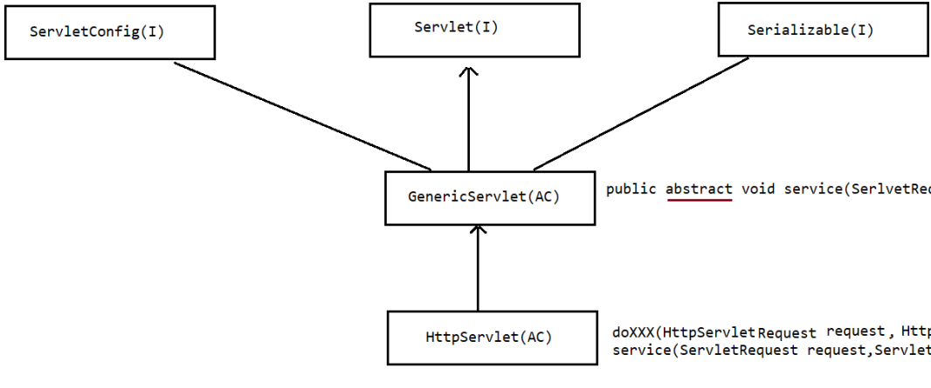
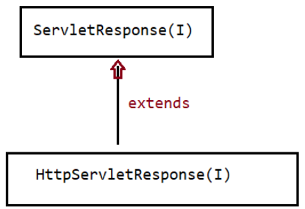

Slide 8
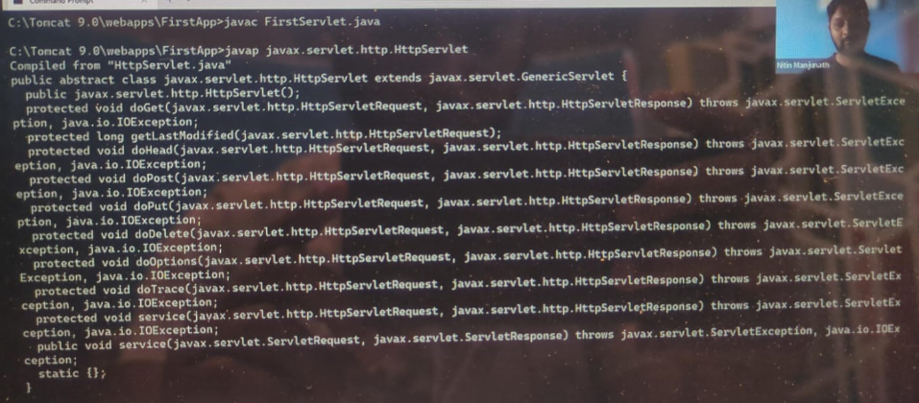
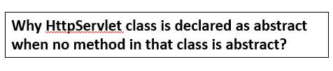
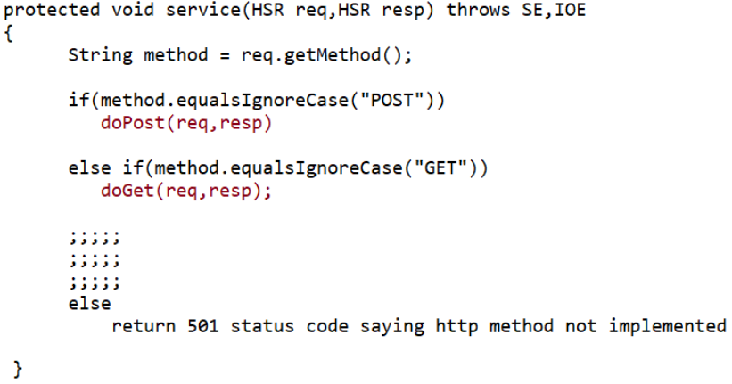
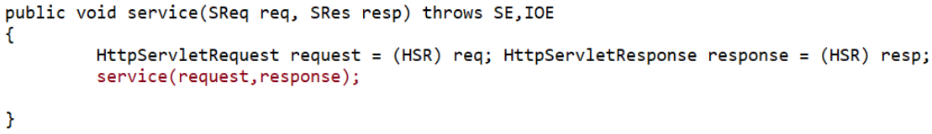
SReq – ServletRequest
SRes – ServletResponse
HSR – HttpServletRequest/Response

Slide 9
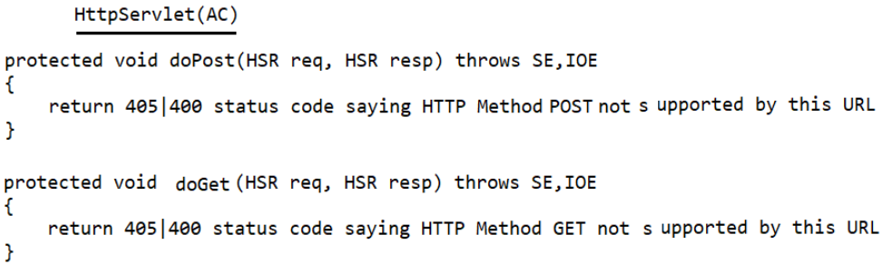
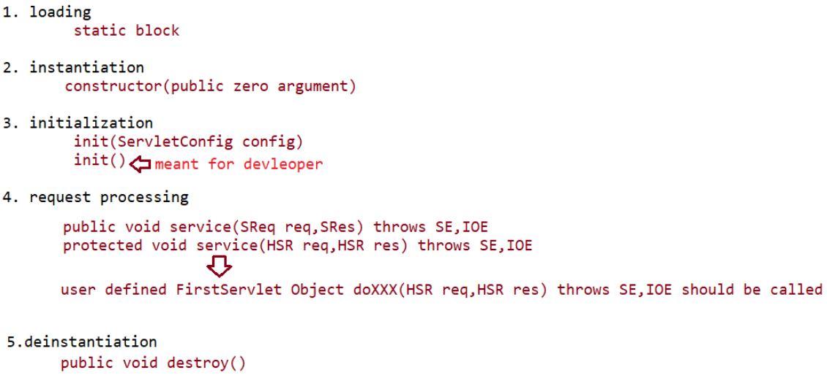
doPost() and doGet() methods of HttpServlet class are not abstract. Don’t you think they must be abstract like service() method of GenericServlet class so that we can define our own custom service functionality of servlet.
If you observe the definition of doPost() and doGet() methods, they serve only one purpose which is returning a code message when there is a client side error. So these instance methods of HttpServlet class are not at helpful for providing services to client request
To make HttpServlet more functional we have to override and give custom definition for doPost() and doGet(), and not use the instance methods of Abstract Class for serving request.
That is the reason HttpServlet class is declared as abstract so that one cannot create object for it as a result cannot use it’s instance doPost() and doGet() methods. Instead, create a concrete class which extends HttpServlet abstract class and override doPost() and doGet() methods creating customized service
If you didn’t give any definition for doPost() or doGet() methods in your concrete class then Instance methods of HttpServlet Abstract Class are executed any way.

Slide 10
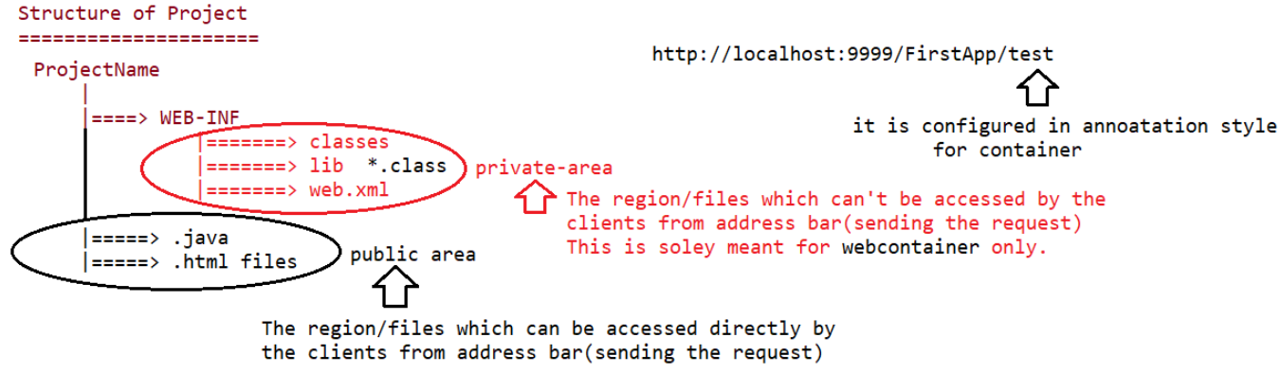
folder
src folder
Server isn’t processing any html files present outside WEB-INF, user can directly access them. But for servlet and other files inside WEB-INF server has process and send it to client.
Every Web Application must be present in a ProjectFolder/(WEB-INF,SRC)
Java Standard Edition – Core java(Until JDBC); only one thread i.e main thread (and from this thread we do multi threading)
Java Enterprise Edition – Servlets, JSP,JSTL, Thymleaf ……. (Server here maintains a thread pool to serve multiple users at a time using multiple threads instead of one single main thread)
So there is no main method in WEB APPS (Web Applications)
5. All the Web Applications must present in Web-Apps directory of the Tomcat 9.0 folder
6. What is tomcat ? – It is server provided by the third party vendor to host our Web application written Java.
7. What is present in lib folder of Tomcat directory and what is servlet-api.jar?
8. How many methods are there inside Servlet Interface? – 5 life cycle methods. – What are they?
9. What is the use of load-on-startup tag in web.xml or loadOnStartup attribute in WebServlet annotation?
10. Explain Servlet Interface, What is the need of GenericServlet and HttpServlet?
11. Who would give implementation for Servlet, ServletRequest, ServletResponse, ServletConfig interfaces?

Slide 11
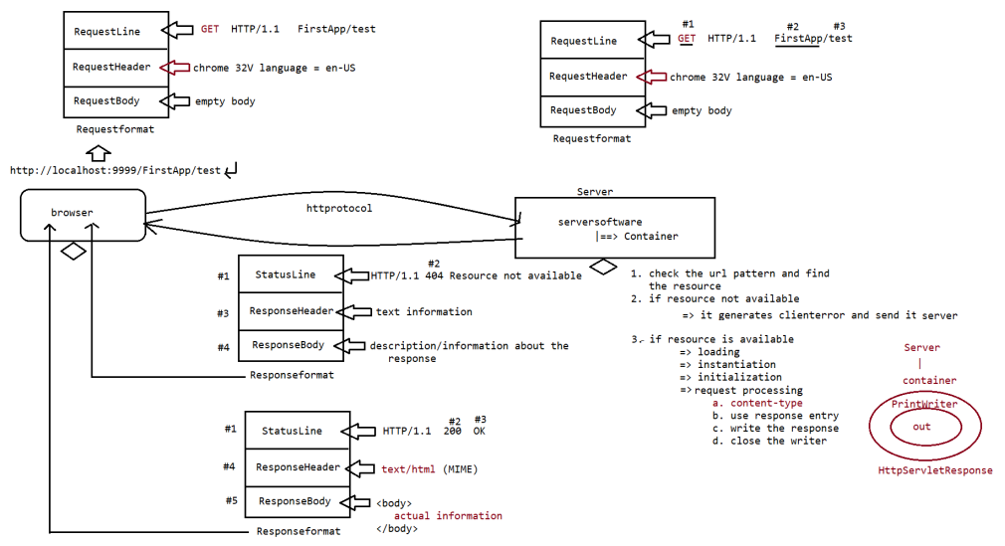
to client
If resource not available
If resource available

Slide 12
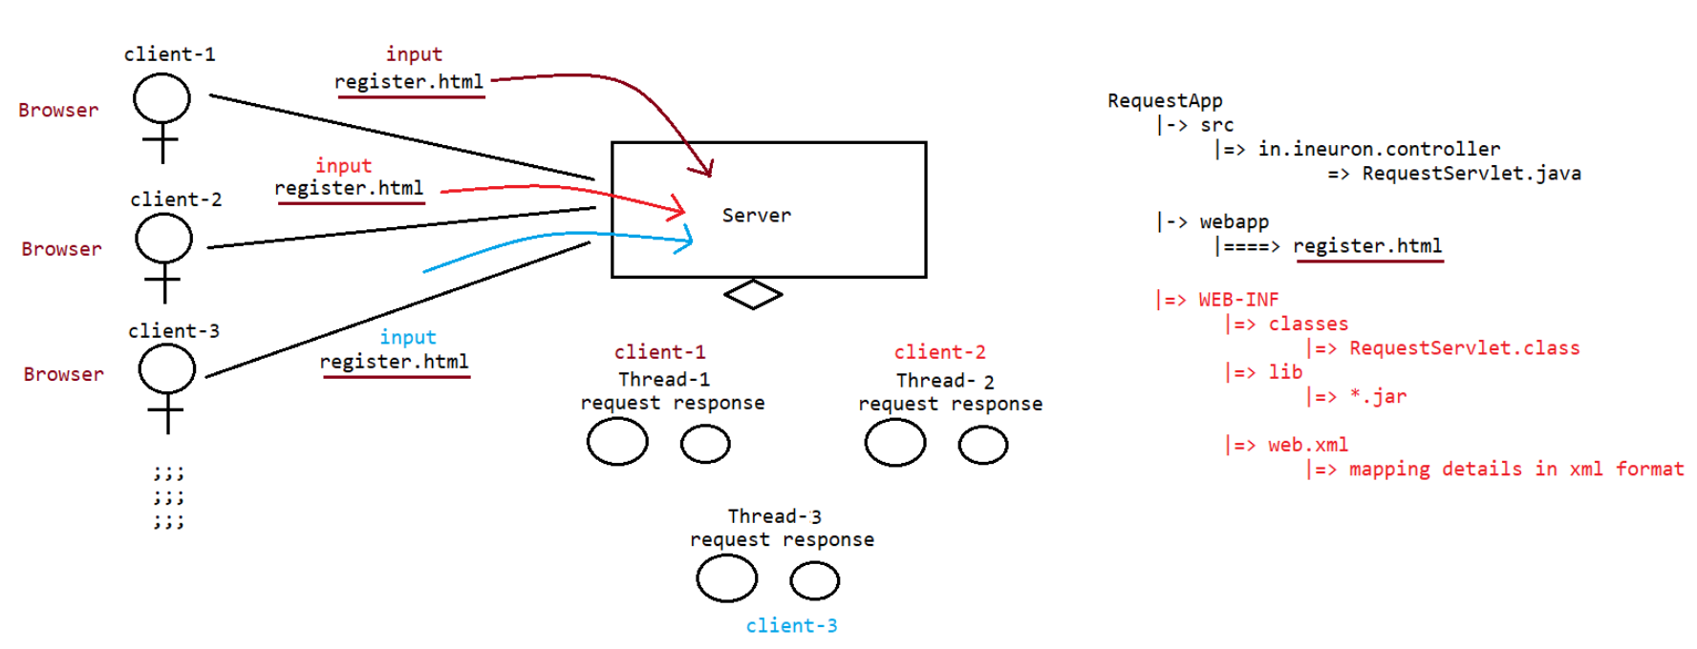

Slide 13
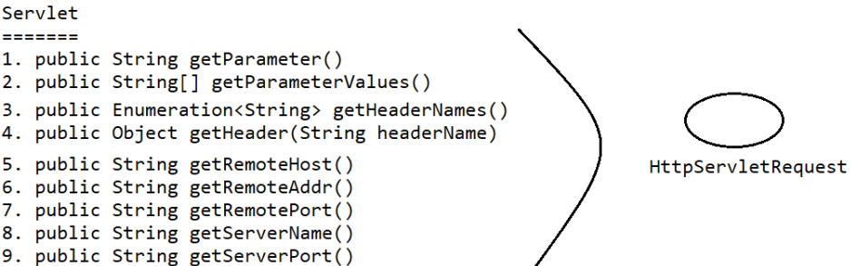
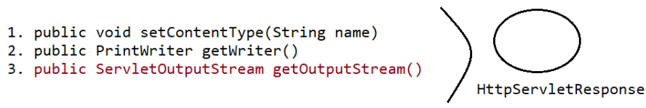
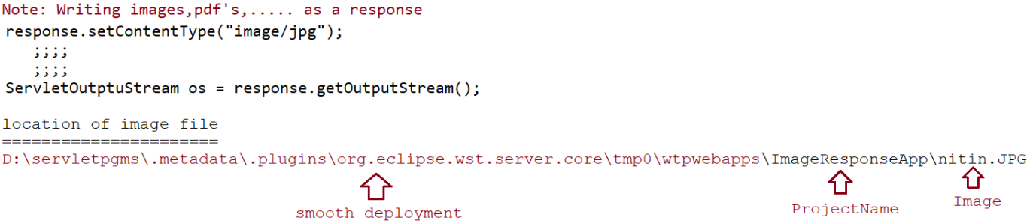
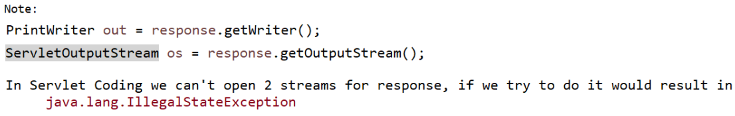

Slide 14
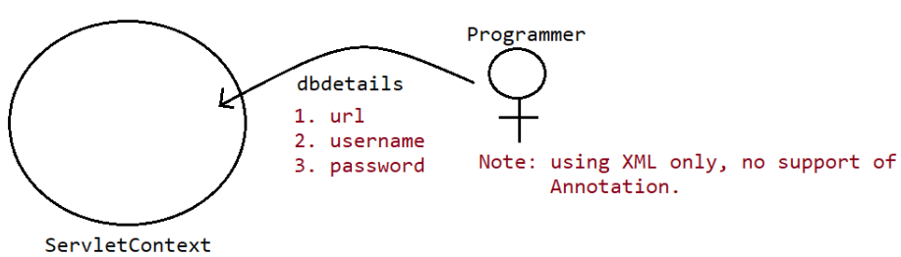
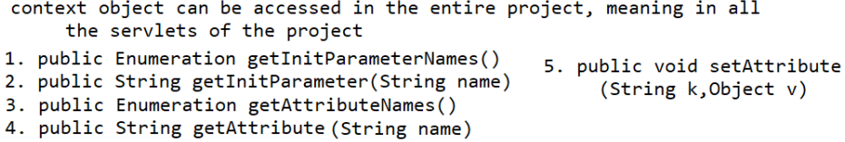
ServletContext is also an Interface
This ServletContext Object can be accessed by everyone in the entire project i.e all the servlets present in the project can access it.
ServletContext context = getServletContext();
These are also there.
Find about them -
request.setAttributeNames()
request.getAttribute()
request.setAttribute()
Parameter Data is Static
Attribute Data is Dynamic
getServletContext().setAttribute(String AttName, Obj AttValue)

Slide 15
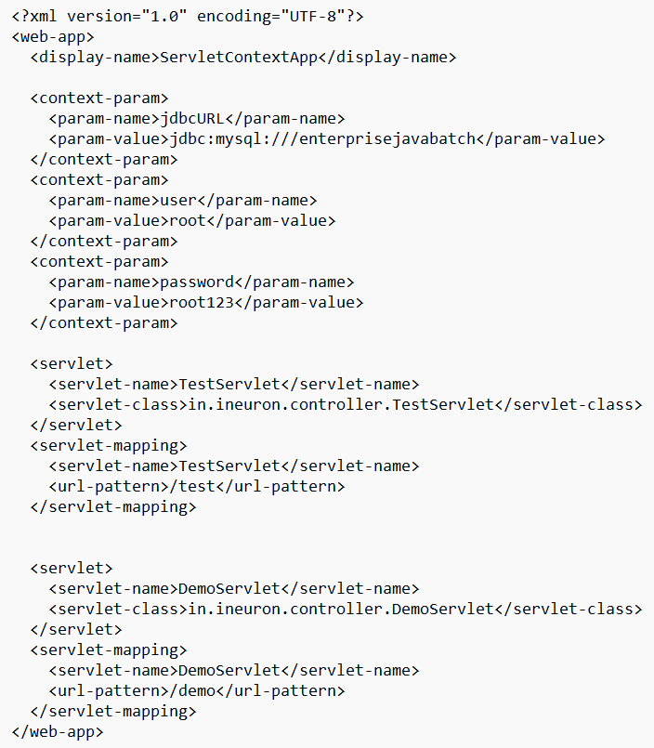
Only static parameters of servlet context are common for all servlets present in the web application. Dynamic attributes set by a servlet using setAttribute() cannot be accessed by other servlets.
@WebServlet() Annotation can be used only for servlet and url mapping but not for setting parameter values in case of ServletContext. Use only xml file for setting parameter values.

Slide 16
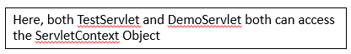
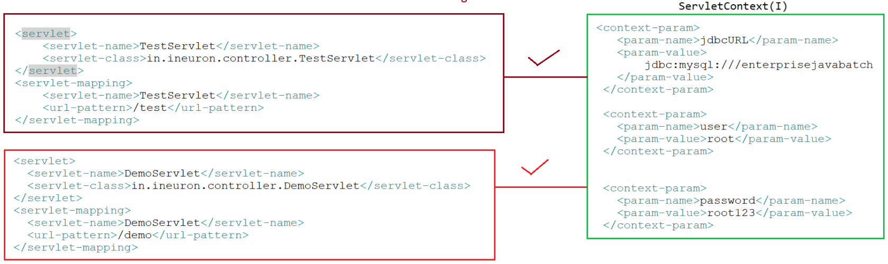

Slide 17
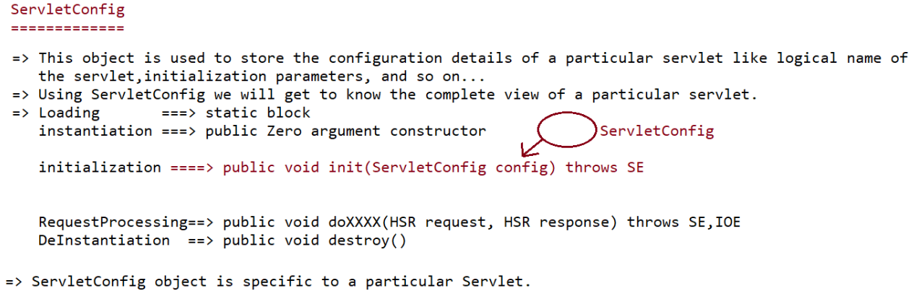
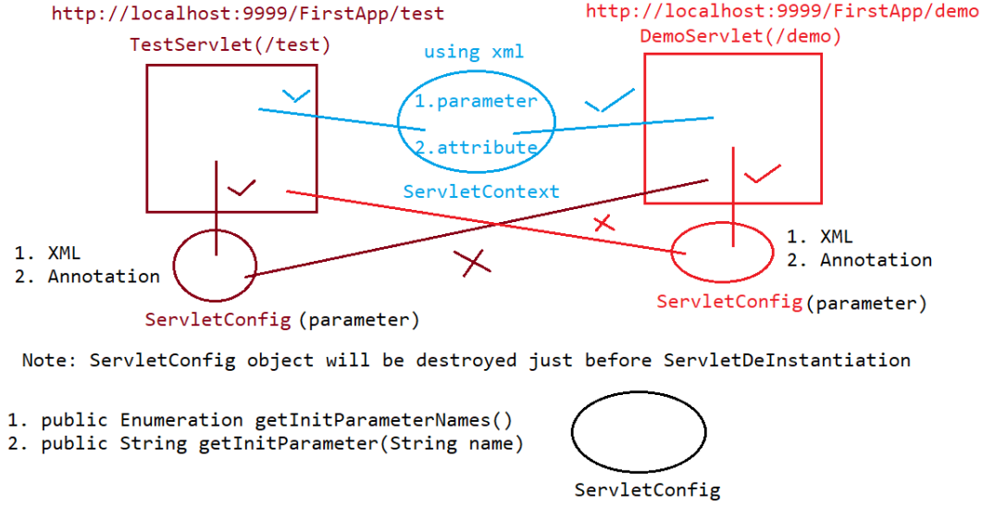
Created automatically after Instantiation and injected while Initialisation

Slide 18
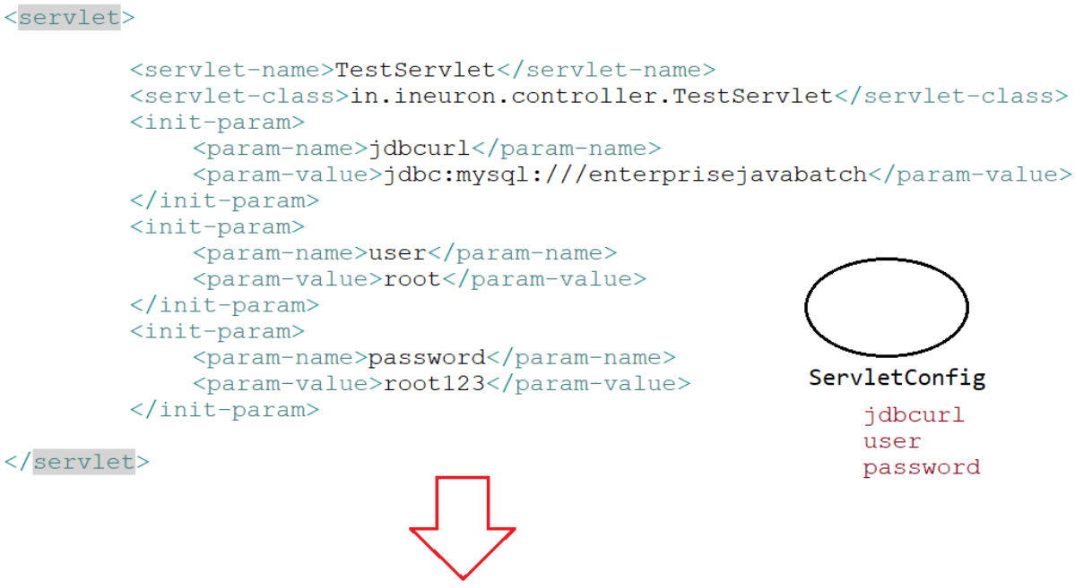
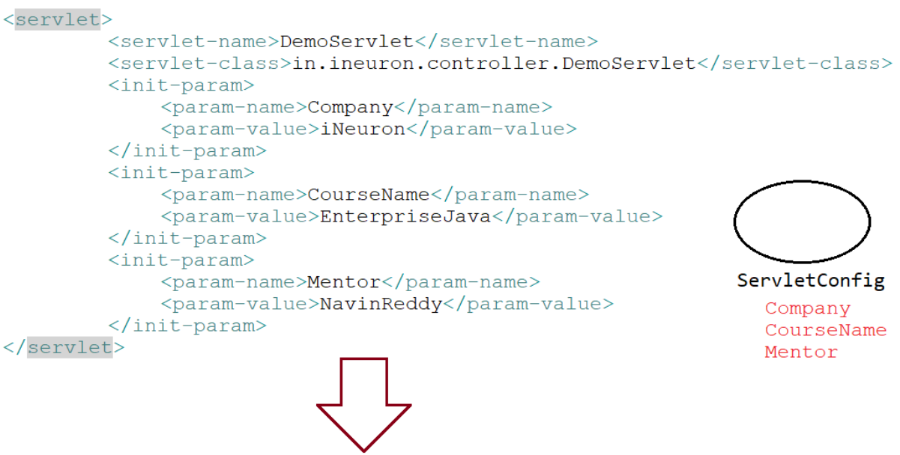
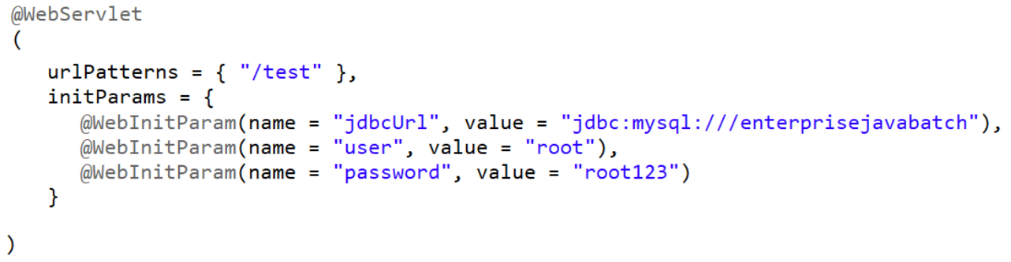


Slide 19

Any changes in web.xml context-param doesn’t reflect in the Application unless you restart the server and redeploy the Application. Because ServletContext Object is created when you deploy the Web Application.
Similarly any changes in web.xml init-param doesn’t reflect in the Application because ServletConfig object is created during initialization.
Everything present in web.xml is static you cannot change during runtime. But you can see the change done to dynamic attributes of ServletContext during runtime.
ServletConfig doesn’t have attributes like ServletContext

Slide 20

DEVELOP AN APPLICATION USING SERVLET + JDBC

Slide 21


response.sendRedirect()
deprecated

Slide 22



This response would not be visible to the client because it’s flushed and response of /test2 is sent.
When request dispatching is used, after forwarding the request, the url of the first servlet on the address bar of browser is not changed to the second servlet is not.
Relative Path : It indicates we need to write path from the current directory(./ or /)
Absolute Path : It indicates we need to write path from the root.
Using absolute path is a good practice.

Slide 23




Location of redirect
getServletContext().getContext(/WebApplicationName).getRequestDispatcher(“/urlpatternofservlet”)

Slide 24


Slide 25





Used in real time applications

Slide 26

Internally a cookie is created and all the values are stored from responses belonging to same sessionId

Slide 27



Slide 28


response.addCookie(new Cookie(param-name, value))
Both httpsession tracking and cookiesession tracking mechanisms are based on cookie cooncept

Slide 29

response.encodeURL(url) this adds sessionId at the end of the url

Slide 30

<input type=‘hidden’ name=‘’ value=‘’/>

Slide 31

IMPORTANT FOR SPRING AND MVC
Serlvet’s purpose is not to do these tasks. It’s purpose is to be as controller. That’s why we need one more component between client and server that is Filter. It is present inside Web Container.

Slide 32

javax.servlet.Filter is an interface
void init(FilterConfig config) {
}
void doFilter(ServletRequest request, ServletResponse response, FilterChain chain) throws ServletException{
//preprocessing logic (before servlet executed)
chain.doFilter(request,response);//pass the request along the filter chain
//postprocessing logic (after servlet executed)
}
void destroy(){
}
url pattern for both servlet and filter must be same for mapping those filter and servlet.
@WebServlet(x)
@WebFilter(x)
If there are multiple servlets and one filter to be mapped with all those servlets use asterisk(*) as url pattern for filter.
@WebFilter(*)

Slide 33


learn about FilterConfig.getServletContext()

Slide 34


Slide 35





